Slide 1
Semantic Segmentation for M detection
20210824 강현정

Slide 2
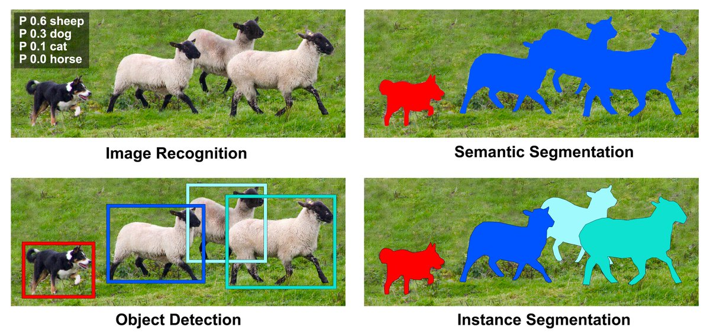
Semantic Segmentation
Semantic Segmentation : 서로 같은 class에 속하는 객체는 서로 같은 객체로 인식
One-stage Detector (U-Net, DeepLab, SegNet,…)
Instance Segmentation : 서로 같은 class에 속하는 객체도 서로 다른 객체로 인식
Two-stage Detector (Mask R-CNN)
< heavier!
Notes:
ca16a5ad-b106-4e84-8a43-178710e854ba.png

Slide 3

Dataset
Old Version
31 patients
1283 images
New Version
8 patients
1228 images
2021S 011852901010_spline.json
┖ Files
┖ File Name : 240
Splines : [[240, 34],
[241, 34],
…
[50,100]]
┖ File Name : 241
2021S 011852901010/240.json
┖ Files
┖ Splines : [[240, 34],
[241, 34],
…
[50,100]]
Notes:
ca16a5ad-b106-4e84-8a43-178710e854ba.png

Slide 4
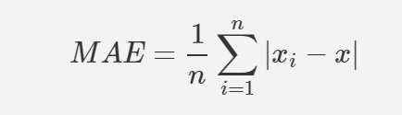
DeepLabV3
Ground Truth
Detection Result
Accuracy : 92.33%
MAE : 0.0003%
F1 Measure : 72.34%
S Measure : 77.85%
E Measure : 90.87%
1 | 0 | 0 | 0 | 0
1 | 1 | 0 | 0 | 0
1 | 1 | 1 | 0 | 0
1 | 1 | 1 | 1 | 0
0 | 0 | 0 | 0 | 0
1 | 1 | 1 | 1 | 0
1 | 1 | 1 | 1 | 0
1 | 1 | 1 | 1 | 0
0 | 0 | 0 | 0 | 0
0 | 0 | 0 | 0 | 0
structure similarity
True Positive : 6
True Negative : 9
False Positive : 6
False Negative : 4
Accuracy : 15/25=0.6
MAE : 0.399
Precision : 6/12 = 0.5
Recall : 6/10 = 0.6
F1 Measure : 0.55
global + local
0.0003 mae, 0.7234 max-fmeasure, 0.9087 max-Emeasure, 0.7785 S-measure..
Fan, D. P., Gong, C., Cao, Y., Ren, B., Cheng, M. M., & Borji, A. (2018). Enhanced-alignment measure for binary foreground map evaluation. arXiv preprint arXiv:1805.10421.
Fan, D. P., Cheng, M. M., Liu, Y., Li, T., & Borji, A. (2017). Structure-measure: A new way to evaluate foreground maps. In Proceedings of the IEEE international conference on computer vision (pp. 4548-4557).
Notes:
ca16a5ad-b106-4e84-8a43-178710e854ba.png

Slide 5
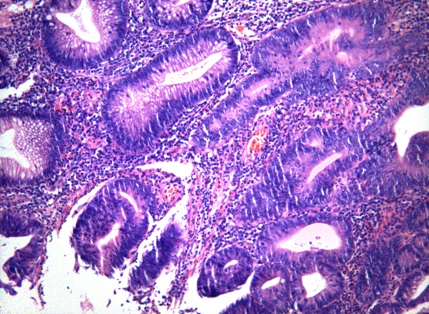


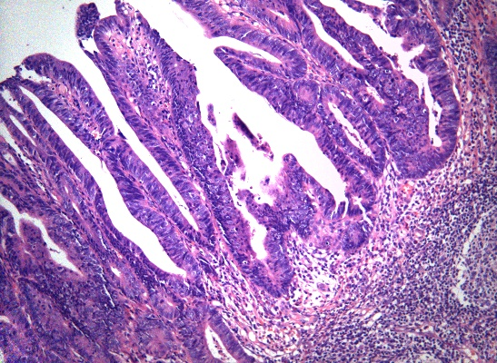


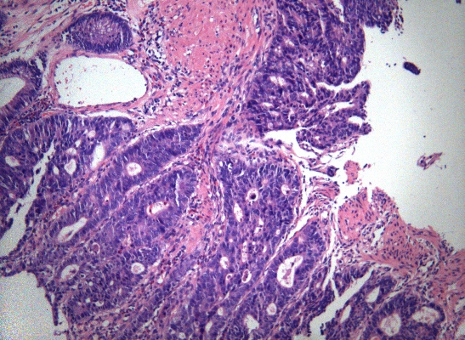


DeepLabV3
2021S 0118390020101-424
Acc : 77.44
F1 : 71.5
MAE : 0.23
2021S 0118390020102-253
Acc : 88.55
F1 : 88.02
MAE : 0.11
2021S 0120351030101-585
Acc : 91.87
F1 : 90.96
MAE : 0.08
Notes:
ca16a5ad-b106-4e84-8a43-178710e854ba.png

Slide 6
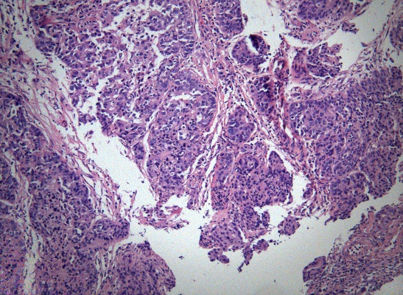


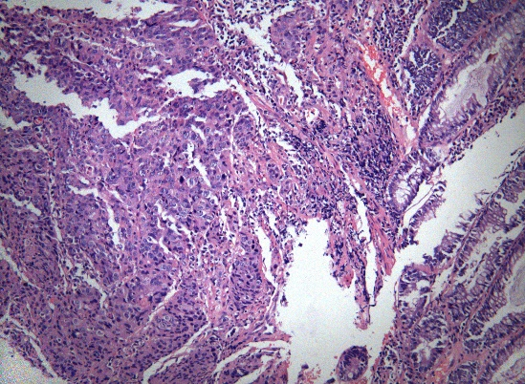


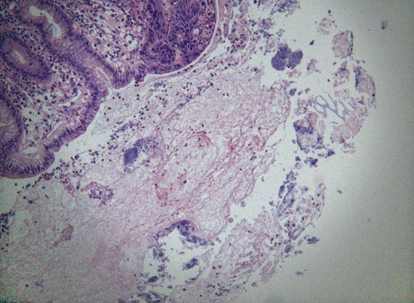


DeepLabV3
2021S 0115077050101-522
Acc : 82.7
F1 : 82.06
MAE : 0.17
2021S 0115077050101-227
Acc : 77.07
F1 : 44.19
MAE : 0.23
2021S 0116781010101-1193
Acc : 94.83
F1 : 40.36
MAE : 0.05
Notes:
ca16a5ad-b106-4e84-8a43-178710e854ba.png

Slide 7
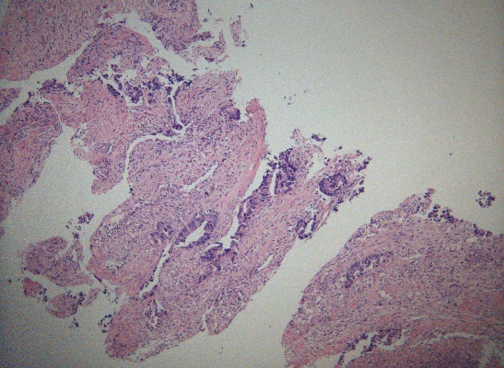


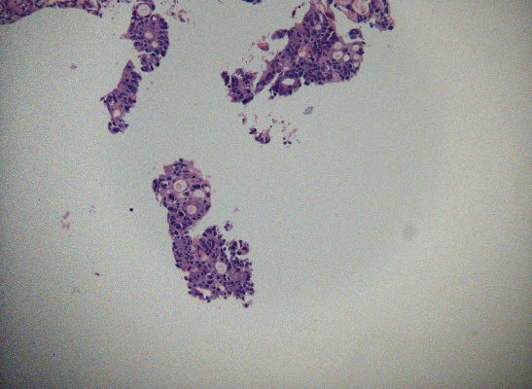


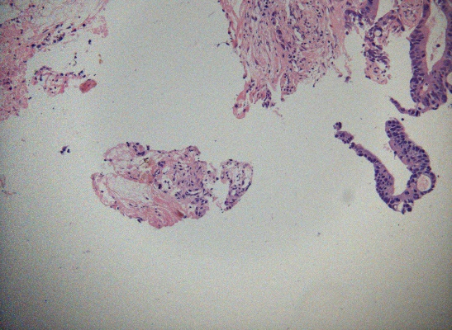


DeepLabV3
2021S 0124324010101-279
Acc : 95.64
F1 : 64.96
MAE : 0.04
2021S 0124324010101-399
Acc : 98.67
F1 : 93.15
MAE : 0.01
2021S 0124324010101-599
Acc : 98.12
F1 : 85.28
MAE : 0.02

Slide 8
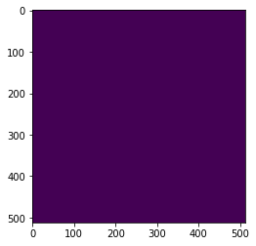
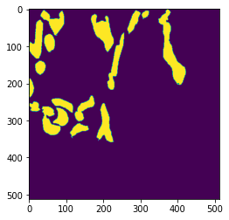
MaskRCNN
There’s no problem during training but still not trained
Detection Result
Ground Truth

Slide 9
DeepLabv3 with normal images
Dataset : 11 patients
84 images
Normal : 18 images
Non-Normal : 68 images
Most of images are predicted as “At least one malignant lesion exists”

Slide 10
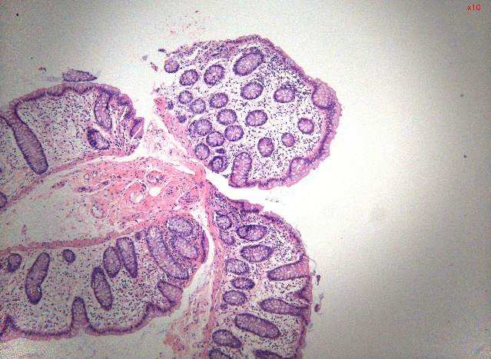

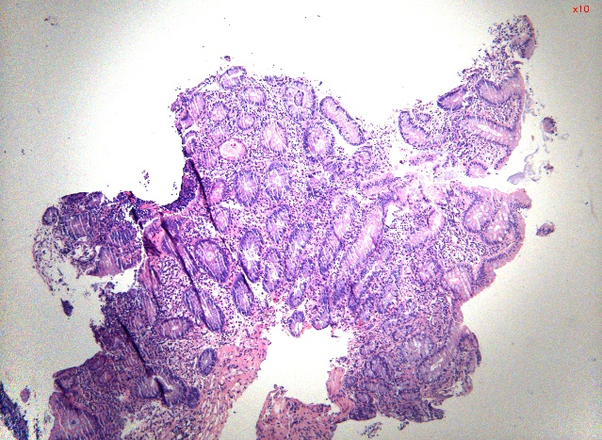

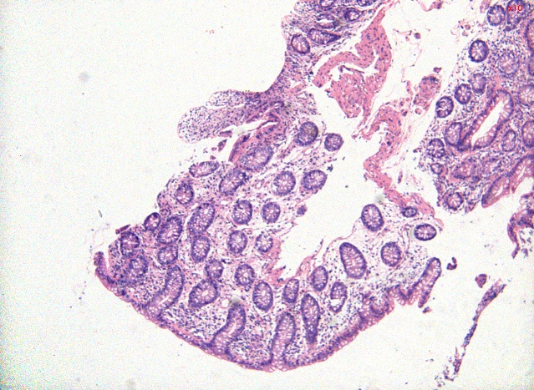

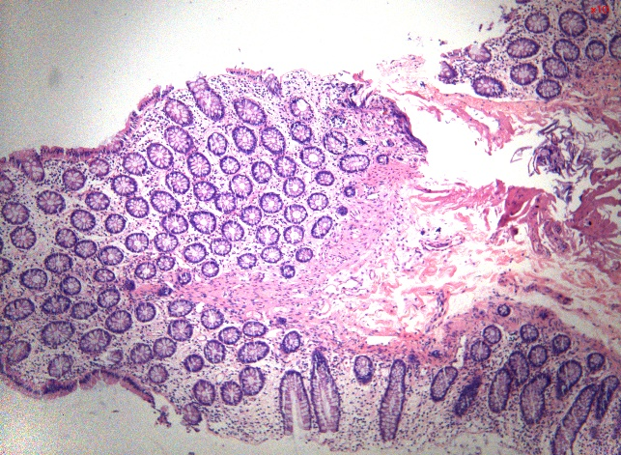
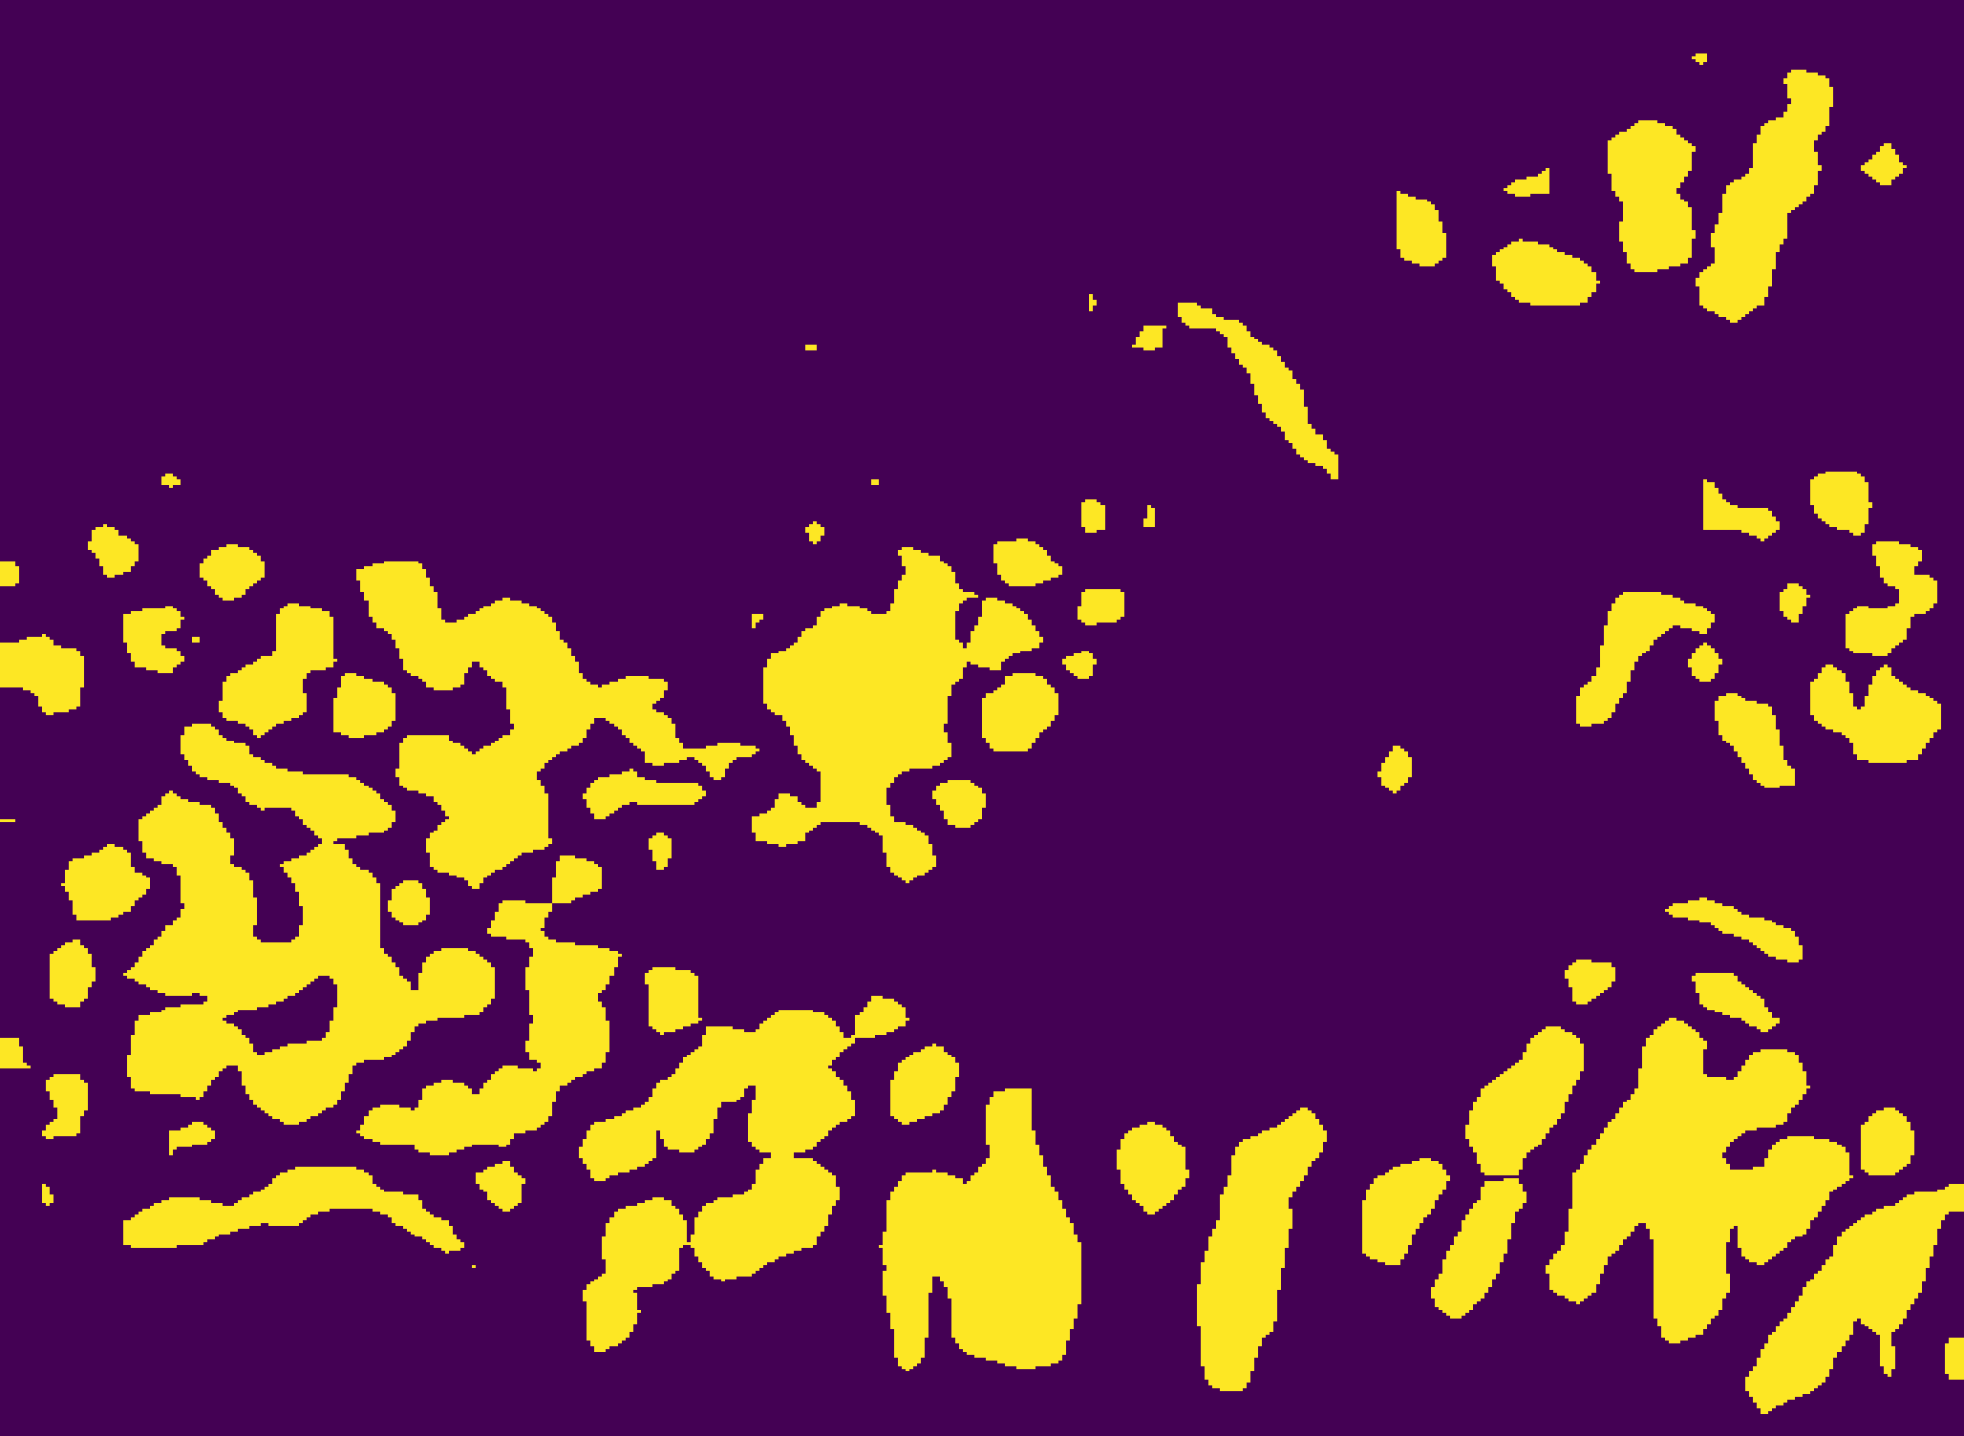
DeepLabv3 with normal images
2021S 0302280010101-107
2021S 0302552010101-75
2021S 0302545010101-26
2021S 0302555030101-20

Slide 11
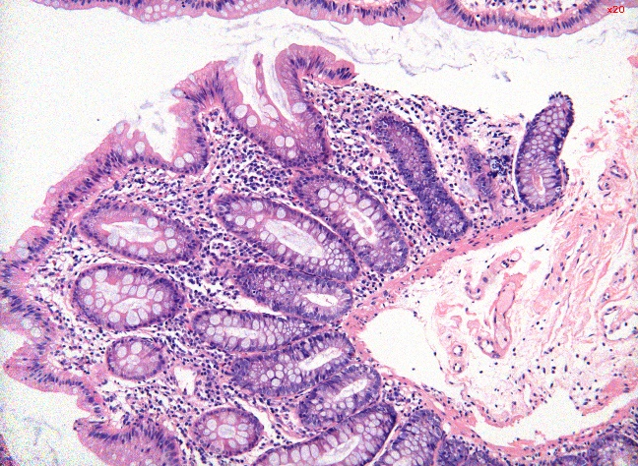

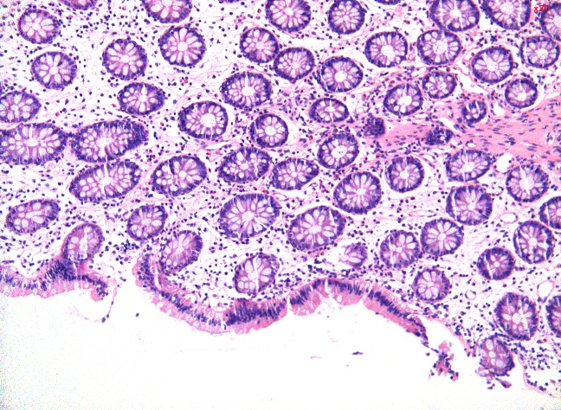

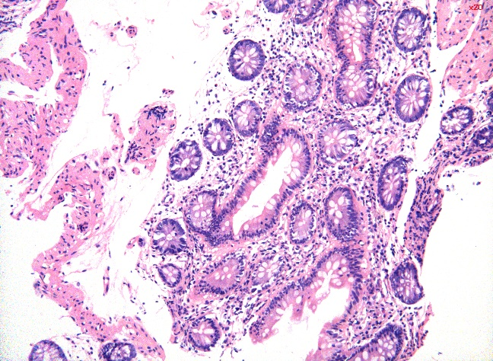

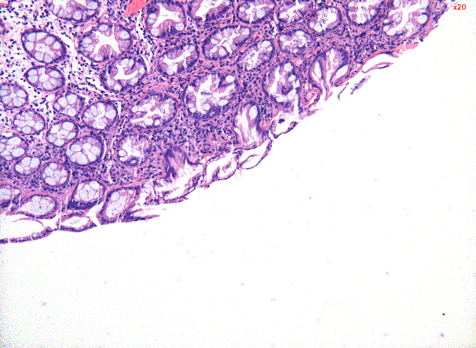

DeepLabv3 with normal images
2021S 0302280010101-447
2021S 0302555030101-157
2021S 0302545010101-207
2021S 0302587020101-81

Slide 12
DeepLabv3 with normal images
Dataset : 11 patients
84 images
Normal : 18 images
Non-Normal : 68 images
Most of images are predicted as “At least one malignant lesion exists”

Slide 13
Thank you :-)

